Slide 1
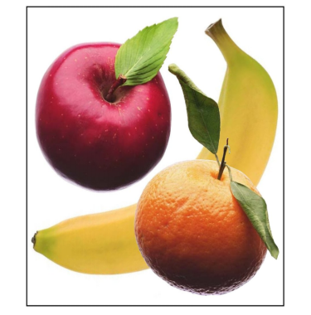
Fruit

Slide 2
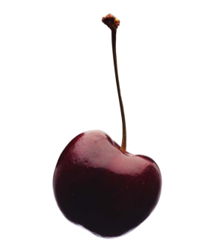
This is a cherry.

Slide 3
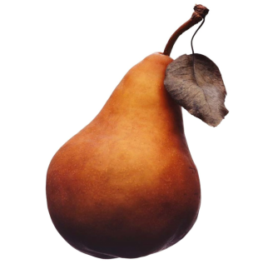
This is a pear.

Slide 4
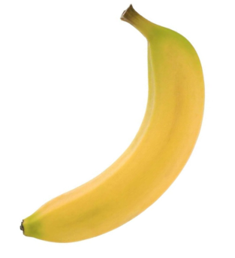
This is a banana.

Slide 5
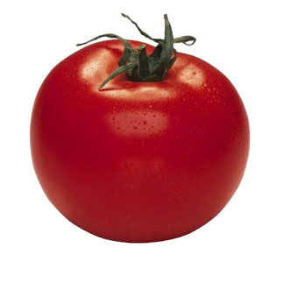
This is a tomato.

Slide 6
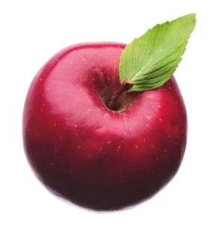
This is an apple.

Slide 7
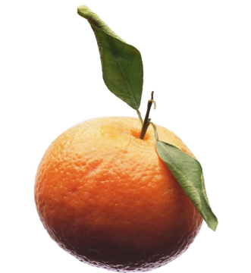
This is an orange.

Slide 8
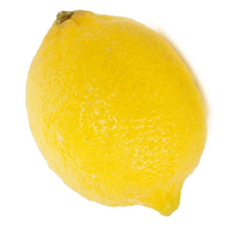
This is a lemon.

Slide 9
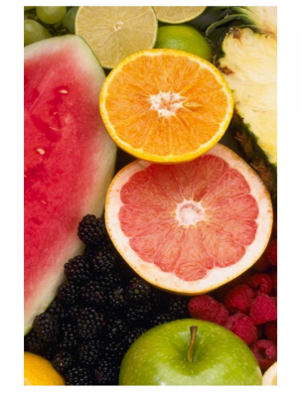
This is fruit.

Slide 10
Cherry
Pear
Banana
Tomato
Apple
Orange
Lemon
Fruit
Click on the colored buttons to start getting to know them!

Slide 11
This is a cherry.
Return

Slide 12
This is a pear.
Return

Slide 13
This is a banana.
Return

Slide 14
This is a tomato.
Return

Slide 15
This is an apple.
Return

Slide 16
This is an orange.
Return

Slide 17
This is a lemon.
Return

Slide 18
This is fruit.
Return

